Slide 1
Functions
Lecture 6
Discrete Mathematical Structures

Slide 2
At the Last Class …
Part I: Basic Operations on Relations
  Set operations on relations
  Inverse
  Composition
  Closure of Relation
Part II: Computer Representation and Warshall’s Algorithm
  Computer of Relations in Computer
  Transitive closure and Warshall’s Algorithm

Slide 3
Functions
Part I: Basics of Functions
  Function as a class of special relations
  Types of functions
  Permutation: bijection on one set
Part II: Functions and Computer Science
  Commonly used function in computer applications
  Growth of functions

Slide 4
Definition of Function
Definition: Let A and B be nonempty sets. A function f from A to B, which is denoted f:A→B, is a relation from A to B such that for all a∈A, f(a) contains just one element of B.
  A special kind of binary relation
  Under f, each element in the domain of f has a unique image.
  Note: the domain of ƒ:A→B is A，but the range is not necessarily equal to B.
  If A,B are nonempty sets, there are |B|^{|A|} different functions from A to B.

Slide 5
Image and counterimage
Let f:A→B, A’⊆A, then ƒ(A’)={y|y=f(x)，x∈A’} is called the image of A’ under f.
  An element in Dom(f) corresponds a value
  A subset of Dom(f) corresponds an image
Let B’⊆B, then f⁻¹(B’)={x|x∈A, f(x)∈B} is called the counterimage of B’ under f.
  Note: A’⊆ f ⁻¹(f(A’)) for all A’⊆A, but the equality is not necessarily holding.

Slide 6
Image and Counterimage
A’
B’
B
A
f

Slide 7
Special Types of Functions
Surjection
  ƒ:A→B is a surjection or “onto” iff. Ran(ƒ)=B, iff. ∀y∈B, ∃x∈A, such that f(x)=y
Injection (one-to-one)
  ƒ:A→B is one-to-one iff. ∀y∈Ran(f), there is at most one x∈A, such that f(x)=y iff. ∀x₁,x₂∈A, if x₁≠x₂，then ƒ(x₁) ≠ƒ(x₂) iff. ∀x₁,x₂∈A, if ƒ(x₁) =ƒ(x₂)，then x₁=x₂
Bijection(one-to-one correspondence)
  surjection plus injection

Slide 8
Special Types of Functions: Examples
ƒ:R→R, ƒ(x)= -x²+2x-1
ƒ:Z⁺→R, ƒ(x)= ln x, one-to-one
ƒ:R→Z, ƒ(x)= ⎣x⎦, onto
ƒ:R→R, ƒ(x)= 2x-1，bijection
ƒ:R⁺→R⁺, ƒ(x)= (x²+1)/x
ƒ:R×R→R×R, ƒ(<x,y>) = <x+y, x-y>, bijection
  Note: ƒ({<x,y>|x,y∈R, y=x+1})=R×{-1}
ƒ:N×N→N, ƒ(<x,y>) = | x²-y²|
  Note: ƒ(N×{0}) ={ n²|n∈N}, but ƒ⁻¹({0}) ={<n,n>|n∈N}

Slide 9
Characteristic Function of Set
Let U is the universal set, for any A⊆U, the characteristic function of A, χ_{A}:U→{0,1} is defined as χ_{A}(x)=1 iff. x∈A
The one-to-one correspondence between ρ(U), the power set of U, and all possible characteristic functions of A, χ_{A}:U→{0,1}

Slide 10
Natural Function
R is an equivalence relation on set A, g : A→A/R, for all a∈A, g(a)=R(a), then G is called a natural function on A
Natural function is surjection
  For any R(a)∈A/R, there exists some x∈A，such that g(x)=R(x)

Slide 11
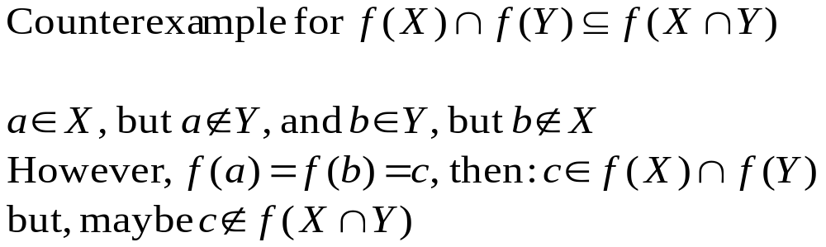
Images of Union and Intersection
Given f：A→B，and X,Y are subsets of A, then:
  f (X∪Y) = f(X)∪f (Y)
  f (X∩Y) ⊆ f(X)∩f (Y)

Slide 12
Composition of Functions
Since function is relation as well, the composition of relation can be applied for functions, with the results being relation.
The composition of functions is still function
  Suppose f :A→B, g:B→C, g°f is a relation from A to C. ∀x∈A, we have g°f (x)=g(f (x)). It is easy to prove that for every a in A, there is just one c in C, such that g(f (a))=c. So, g°f is a function.

Slide 13
Composition of Functions
gf
f
g
a
b=f(a)
c=g(b)=gf (a)
A
B
C

Slide 14
Associative Law
The composition of function is simply the composition of relation, so it is an associative operation.
For any functions f :A→B, g:B→C, h:C→D,
  (h°g)°f= h°(g°f)

Slide 15
Composition of Surjections
If f :A→B, g:B→C are both surjections, then g°f:A→C is also surjection.
  Sketch of proof:
  For any y∈C, since g is a surjection, there must be some t∈B, such that g(t)=y. Similarily, since f is surjection，there must be some x∈A, such that f(x)=t, so, g°f(x)=y.

Slide 16
But…
If g°f is a surjection，can it be derived that f and g are both surjections as well？
  Obviously，g must be a surjection.
If there is some t∈B, for any x∈A, f(x)≠t, (i.e. f is not a surjection！) then if only g(B-t)=C, g°f is still a surjection.

Slide 17
Composition is a Surjection
B
A
C
t
f
g

Slide 18
Composition of Injections
If f :A→B, g:B→C are both injections, then g°f:A→C is a injection as well.
  Sketch of proof:
  By contradiction，suppose x₁,x₂∈A, and x₁≠x₂，but g°f(x₁)=g°f(x₂) ，let f (x₁)=t₁, f (x₂)=t₂，
  If t₁=t₂，then f is not a injection.
  If t₁≠ t₂，then g is not a injection.

Slide 19
But…
If g°f is a injection, can it be derived that f and g are both injections？
  Obviously, f must be a injection.
Suppose that t₁,t₂∈B, t₁≠t_{2，}but g(t₁)=g(t₂) , (i.e. g is not a injection!) If only t₁ or t₂ are not in Ran(f), then g°f still may be injection.

Slide 20
Composition is a Injection
B
A
C
t₁
t₂
f
g

Slide 21
Identity Function on a Set
1_{A} is the identity function on A：1_{A}(x)=x for all x∈A.
For any f :A→B，f=1_{B}°f = f °1_{A}
  Sketch of proof:
  Proving that the set f is equal to the set f °1_{A} and 1_{B}°f
  Note: if <x,y>∈f, then <x,y>∈f and <x,x>∈1_{A}
  if <x,y>∈ f °1_{A}，则<t,y>∈ f , 且<x,t>∈1_{A}，
  则t=x, 所以<x,y>∈f .

Slide 22
Invertible Function
The inverse relation of f :A→B is not necessarily a function, even though f is.
  Examples: (Let A={a,b,c}, B={1,2,3})
  f = {<a,1>, <b,2>, <c,1>} is a function, but f⁻¹={<1,a>, <2,b>, <1,c>} is not a function.
f :A→B is called an invertible function, if its inverse relation, f ⁻¹:B→A is also a function.
  Example:
  f : N×N→N, f (<i,j>)=2^{i}(2j+1)-1 is a bijection
  f ⁻¹(2^{i}(2j+1)-1)=<i,j>

Slide 23
Invertible Function
f :A→B has an invertible function is and only if f is a bijection.
  Sketch of proof:
  ⇒ If f is not a injection, then there must be <y,x₁>, <y,x₂>∈ f ⁻¹, and x₁≠x₂. On the other hand, if f is not a surjection, then there is at least on element in B, which has not an image in A under f ⁻¹. Both cases are contradict to “f ⁻¹:B→A is invertible”.
  ⇐ If f ^{–1} is not a function, then，either there exist <y,x₁>, <y,x₂>∈ f ⁻¹, 且x₁≠x₂，then f is not a injection, or there must be at least on element in B, which has not an image in A under f ^{–1}. Both cases are contradict to “f is a bijection”.

Slide 24
Hashing: the Idea
Very large, but only a small part is used in an application
In feasible size
E[0]
Index distribution
Collision handling
E[1]
x
Hash Function
Key Space
E[k]
H(x)=k
Value of a specific key
A calculated array index for the key
E[h-1]

Slide 25
Collision Handling: Closed Address
Each address is a linked list
k₁
k₄
k₁
k₅
k₂
k₇
k₄
k₅
k₂
k₇
k₃
k₆
k₆
k₃

Slide 26
Collision Handling: Open Address
All elements are stored in the hash table, no linked list is used. So, α, the load factor, can not be larger than 1.
Collision is settled by “rehashing”: a function is used to get a new hashing address for each collided address, i.e. the hash table slots are probed successively, until a valid location is found.
The probe sequence can be seen as a permutation of (0,1,2,..., h-1)

Slide 27
Linear Probing: an Example
Index
H
Hash function: h(x)=5x mod 8
0
1776
1
2
1812
3
1055
hashing
4
1492
1945
rehashing
hashing
5
1812
6
1918
Rehash function: rh(j)=(j+1) mod 8
7
1945
chain of rehashings

Slide 28
Hashing Function
A good hash function satisfies the assumption of simple uniform hashing.
Heuristic hashing functions
  The divesion method: h(k)=k mod m
  The multiplication method: h(k)=⎣m(kA mod 1)⎦ (0<A<1)
No single function can avoid the worst case, so, “Universal hashing” is proposed.
Rich resource about hashing function:
Gonnet and Baeza-Yates: Handbook of Algorithms and Data Structures, Addison-Wesley, 1991

Slide 29
Relative Growth Rate
Ω(g):functions that grow at least as fast as g
Θ(g):functions that grow at the same rate as g
g
Ο(g):functions that grow no faster as g

Slide 30
The Set “Big Oh”
Definition
  Giving g:N→R⁺, then Ο(g) is the set of f:N→R⁺, such that for some c∈R⁺ and some n₀∈N, f(n)≤cg(n) for all n≥n₀.
A function f∈Ο(g) if lim_{n→∞}[f(n)/g(n)]=c<∞
  Note: c may be zero. In that case, f∈ο(g), “little Oh”
Example: let f(n)=n², g(n)=nlgn, then:
  f∉Ο(g), since lim_{n→∞}[f(n)/g(n)]= lim_{n→∞}[n²/nlgn]= lim_{n→∞}[n/lgn]= lim_{n→∞}[1/(1/nln2)]=∞
  g∈Ο(f), since lim_{n→∞}[g(n)/f(n)]=0

Slide 31
The Sets Ω and Θ
Definition
  Giving g:N→R⁺, then Ω(g) is the set of f:N→R⁺, such that for some c∈R⁺ and some n₀∈N, f(n)≥cg(n) for all n≥n₀.
A function f∈Ω(g) if lim_{n→∞}[f(n)/g(n)]>0
  Note: the limit may be infinity
Definition
  Giving g:N→R⁺, then Θ(g) = Ο(g) ∩ Ω(g)
A function f∈Ο(g) if lim_{n→∞}[f(n)/g(n)]=c,0<c<∞

Slide 32
How Functions Grow
Algorithm | 1 | 2 |  |  | 3 |  | 4
Time function(ms) | 33n | 46n lg n |  |  | 13n² |  | 3.4n³ |  |  | 2^{n}
Input size(n) | Solution time
10 | 0.00033 sec. |  |  | 0.0015 sec. |  | 0.0013 sec. |  | 0.0034 sec. |  | 0.001 sec.
100 | 0.0033 sec. |  |  | 0.03 sec. |  | 0.13 sec. |  | 3.4 sec. |  | 4×10¹⁶ yr.
1,000 | 0.033 sec. |  |  | 0.45 sec. |  | 13 sec. |  | 0.94 hr.
10,000 | 0.33 sec. |  |  | 6.1 sec. |  | 22 min. |  | 39 days
100,000 | 3.3 sec. |  |  | 1.3 min. |  | 1.5 days |  | 108 yr.
Time allowed | Maximum solvable input size (approx.)
1 second | 30,000 |  | 2,000 |  | 280 |  | 67 |  | 20
1 minute | 1,800,000 |  | 82,000 |  | 2,200 |  | 260 |  | 26

Slide 33
Increasing Computer Speed
Number of steps performed on input of size n f(n) | Maximum feasible input size s | Maximum feasible input size in t times as much time s_{new}
lg n | s₁ | s₁^{t}
n | s₂ | t s₂
n² | s₃ | √t s₃
n³ | s₄ | s₄+lg n

Slide 34


Sorting a Array of 1 Million Numbers
Using merge sort,
taking time 50nlogn:
100 seconds!
Computer B
10 Mips
Computer A
1000 Mips
Using insertion sort, taking time 2n²:
2000 seconds!

Slide 35
Complexity Class
Let S be a set of f:N→R* under consideration, define the relation ~ on S as following: f~g iff. f∈Θ(g)
then, ~ is an equivalence.
Each set Θ(g) is an equivalence class, called complexity class.
We usually use the simplest element as possible as the representative, so, Θ(n), Θ(n²), etc.

Slide 36
Comparison of Often Used Orders
The log function grows more slowly than any positive power of n
lgn ∈ o(n^{α}) for any α>0
The power of n grows more slowly than any exponential function with base greater than 1
n^{k} ∈ o(c^{n}) for any c>1
(The commonly seen base is 2)

Slide 37
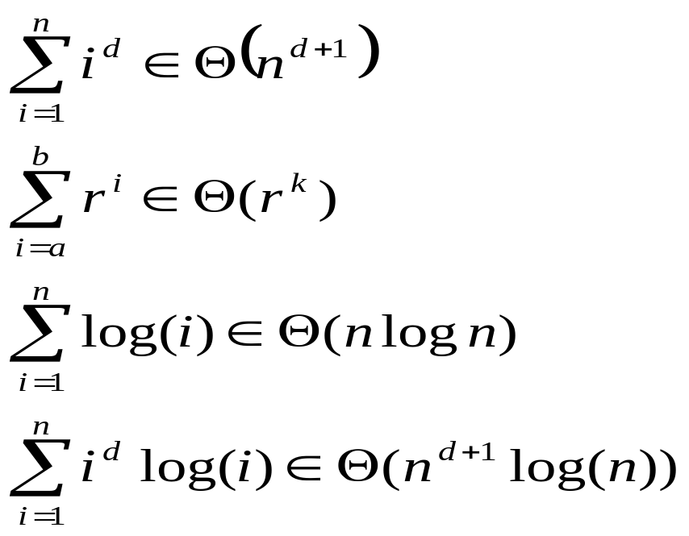
Order of Common Sums
r^{k} is the largest term in the sum
Area=nf(n)
f(n)
f(rn)
rn
(0<r<1)
n
Area=(1-r)nf(rn)

Slide 38
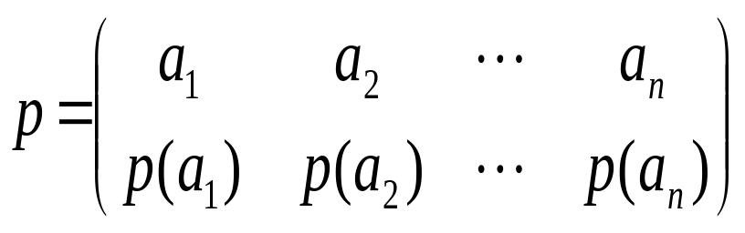
Permutation Function
Definition: A bijection from a set A to itself is called a permutation of A.
Denotation:

Slide 39
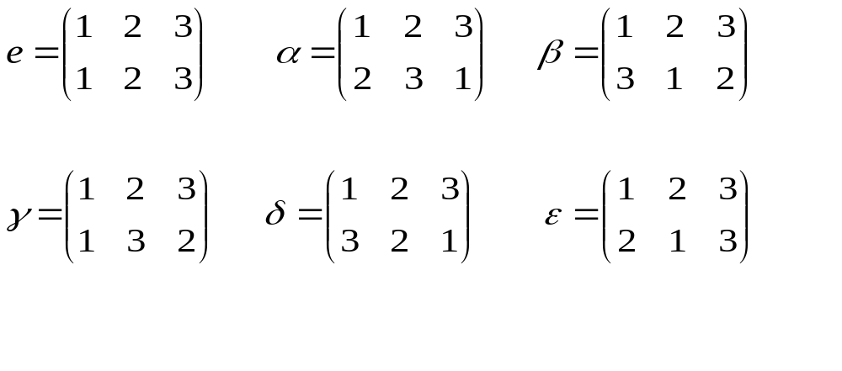
Example of Permutation
S={1,2,3}, there are 6 different
permutations of S:

Slide 40
Cyclic Permutation and Transposition
If p is a permutation of S={1,2,…,n}, and
p(i₁)=i₂, p(i₂)=i₃, …, p(i_{k-1})=i_{k}, p(i_{k})=i₁, for all other x∈S, p(x)=x, then p is called a cyclic permutation of S，when k=2, p is also called a transposition.
Denotation: (i₁ i₂ … i_{k} )
6 permutation of S={1,2,3}:
  e=(1); α=(1 2 3); β=(1 3 2); γ=(2 3); δ=(1 3); ε=(1 2)

Slide 41
Disjoint Cyclic Permutations
Given two cyclic permutations of S:
p =(i₁ i₂ … i_{k} ), q =(j₁ j₂ … j_{s} ),
if {i₁, i₂, …, i_{k}} ∩ {j₁, j₂, …, j_{s}}=φ，then p and q are disjoint.
If p and q are disjoint, then pq=qp
  For any x∈S, there are three cases:
  x∈{i₁, i₂, …, i_{k}};
  x∈{j₁, j₂, …, j_{s}};
  x∈S-({i₁, i₂, …, i_{k}}∪{j₁, j₂, …, j_{s}})，
  it is easy to see (pq)(x) = (qp)(x) in all the three cases

Slide 42
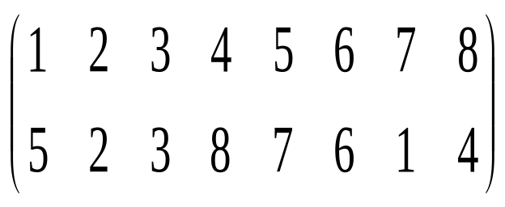
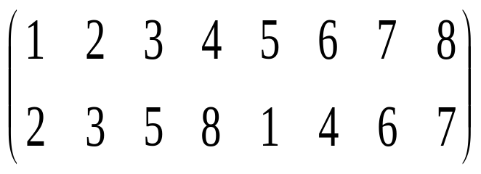
Permutation as Product of Cycles
= (1 5 7) (4 8)
=(1 2 3 5) (4 8 7 6)

Slide 43
Permutation as Product of Transpositions
Every cycle p=(i₁ i₂ … i_{k} ) can be represented as a product of k-1 transpositions (i₁i_{k})(i₁i_{k-1}),…, (i₁i₂)
    The order cannot be changed.
  Proof by induction on k:
  k=2 is trivial. Considering p=(i₁ i₂ … i_{k} i_{k+1} ), we need only to prove that p=(i₁ i_{k+1} )(i₁ i₂ … i_{k}) 。
  There are four cases for any x∈A, p(x)=(i₁ i_{k+1} )(i₁ i₂ … i_{k}) (x)
    (1) x∈{ i₁, i₂, …, i_{k-1}}
    (2) x=i_{k}
    (3) x=i_{k+1}
    (4) otherwise

Slide 44
Permutation as Product of Cycles
Odd
= (1 5 7) (4 8)
=(1 2 3 5) (4 8 7 6)
= (1 7) (1 5) (4 8)
= (1 5) (1 3) (1 2) (4 6) (4 7) (4 8)
Even

Slide 45
Home Assignments
To be checked
  pp.176: 5-8, 11-15, 29-31, 33-34, 40-41
  pp.181: 7-8, 17, 22-24, 29, 30
  pp.187: 11, 21-29
  pp.195: 12-16, 20, 28-30
Self tests
Experiment 5

